Slide 1
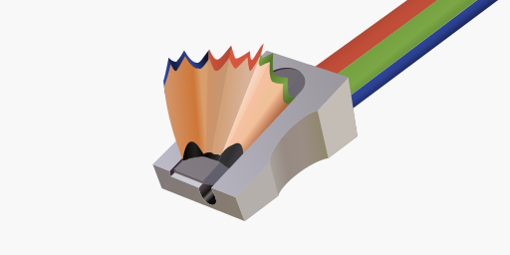
Updating the skia in SkiaSharp

